Slide 1

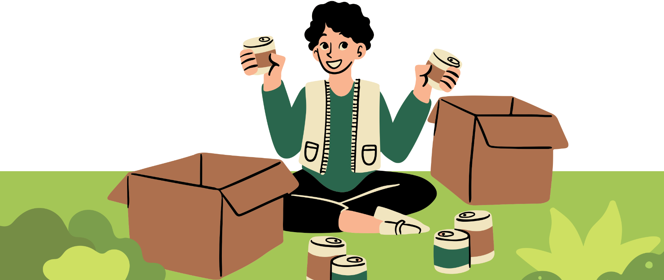
Digital Fundraising:
Unlocking the Potential of Online Giving
DS-670 Capstone
Assignment 2 Presentation
By Kristopher Albano

Slide 2

AGENDA
High Level Architecture
Gantt Chart
Updated Peer-Reviewed Art.
Initial Literature Review
EDA

Slide 3

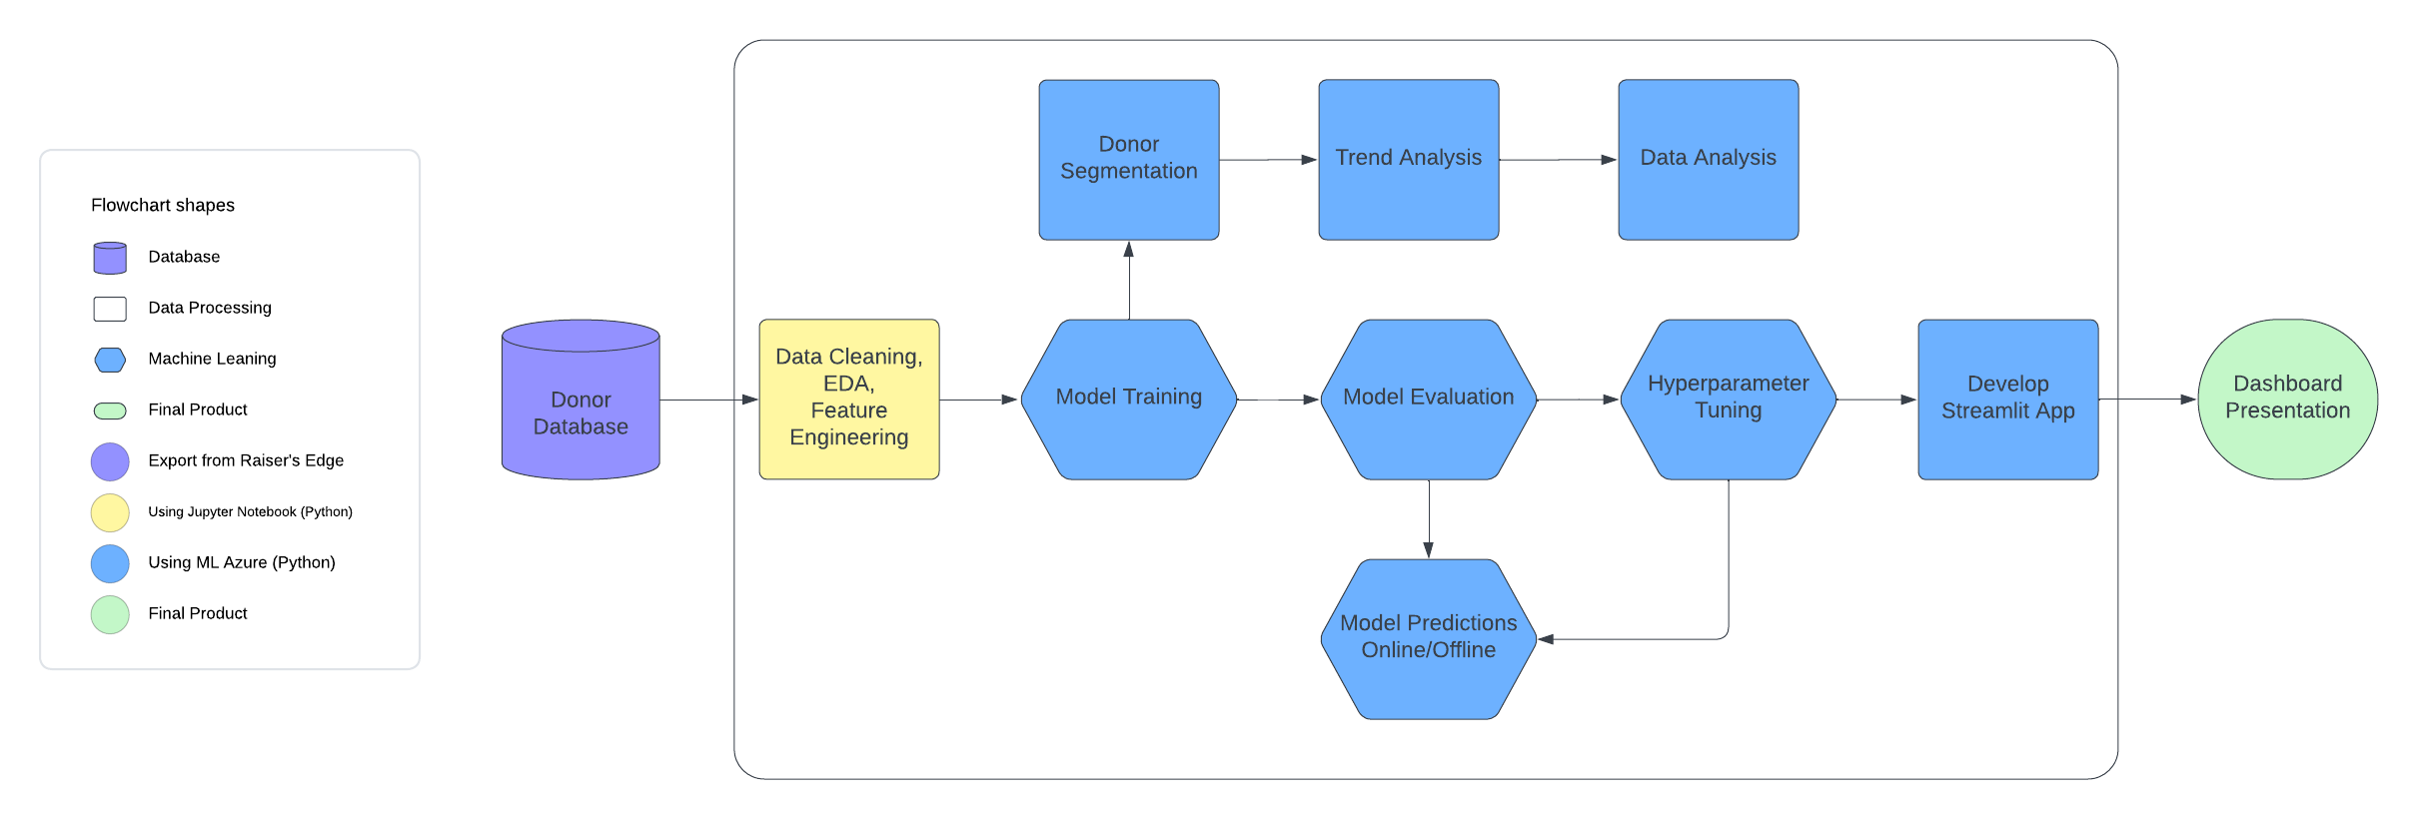
High Level Architecture

Slide 4

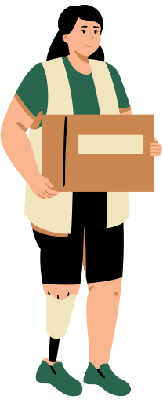

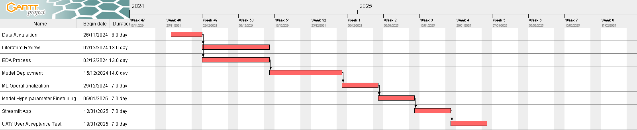
Gantt Chart

Slide 5


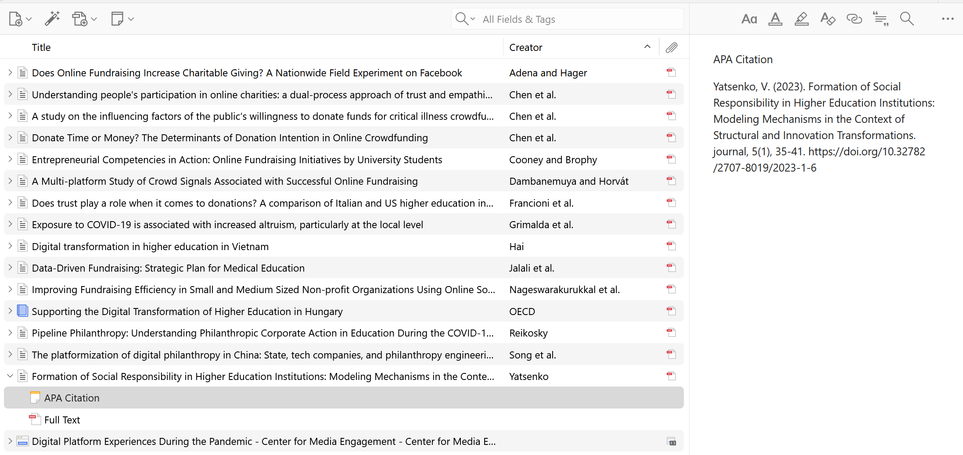
Updated
Peer-reviewed Articles

Slide 6

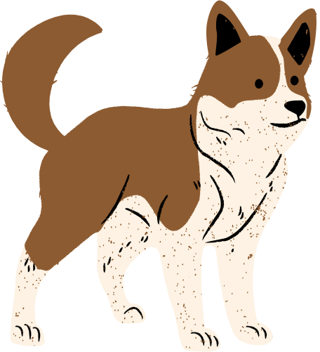





Initial Literature Review
The study by Grimalda et al. (2021) investigated how the exposure to COVID-19 relates to altruistic behavior with a focus on charitable giving at a local, national, and international levels.
A study by Duchovnay et al. (2020) found that people reported an increased use of social media, search engines, and messaging platforms during this time and spent more time using them during the pandemic.
Chen et al. (2021) explored the behavior behind people’s participation in online giving. Their research highlighted the role of trust in motivating online donations.
A study by Nageswarakurukkal et al. (2019) also found that there is a significant percentage of donors willing to donate online but there are challenges that needs to be addressed by the institutions themselves.

Slide 7

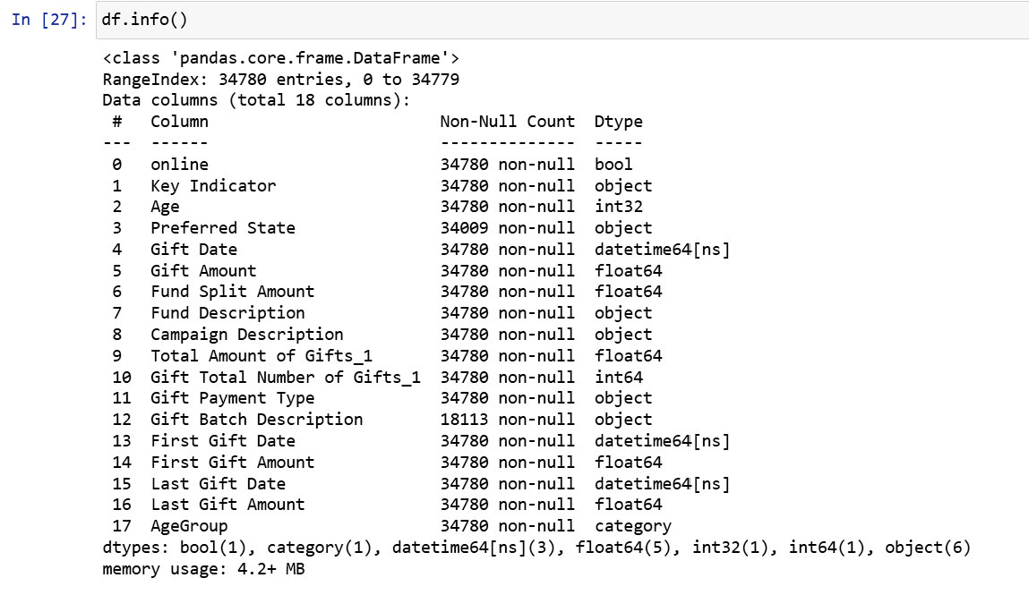
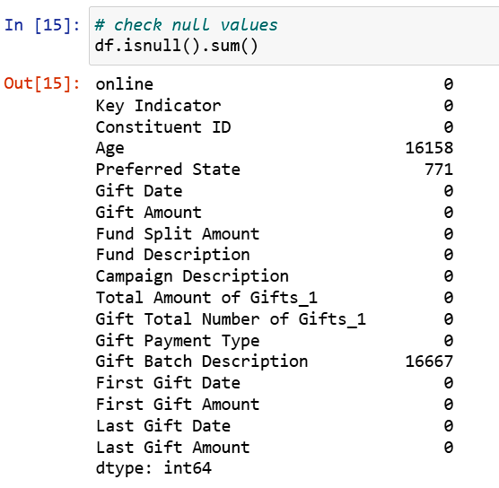

EDA

Slide 8
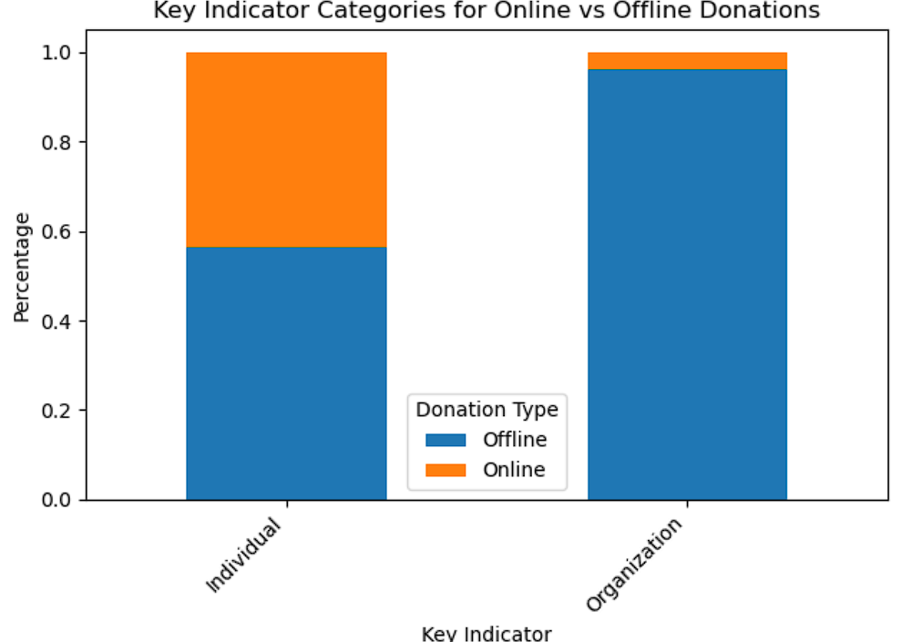
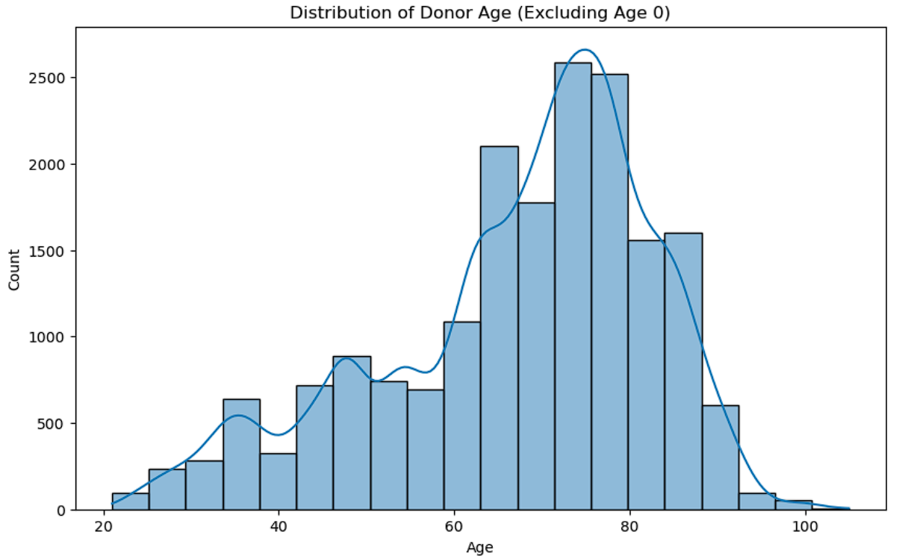
EDA

Slide 9

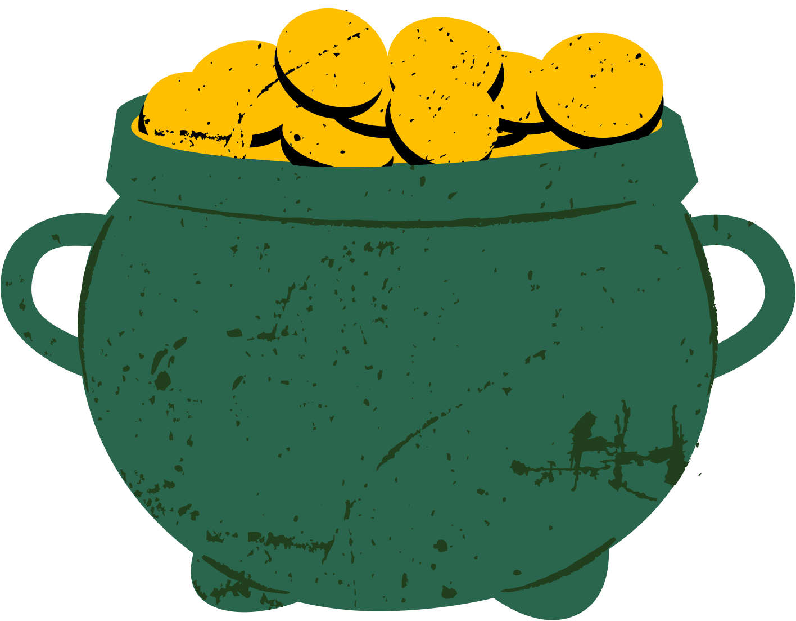

“When one gives, two get happy.”
- Amit Kalantri, Wealth of Words

Slide 10

CREDITS
This presentation template is free for everyone to use thanks to the following:
for the presentation template
Pexels, Pixabay
for the photos
Happy designing!

